Slide 1
Supplier Change Notification (SCN) Portal Training

Slide 2
Vyaire Medical Quality Policy
Vyaire Medical is committed to empowering the global respiratory community to enrich patients’ quality of breathing by providing safe, effective products and services achieved through world class design and manufacture, focusing on customer satisfaction, continuous improvement, and compliance with global regulatory requirements.

Slide 3
Training Goals / Objectives
Collaborative discussion with our key internal customers (“YOU”)
- SCN Purpose
- Vyaire Supporting QMS Documents
- SCN SharePoint Portal Demo
- Understanding the roles
- SCN Status Definitions

Slide 4
SCN Purpose
Purpose: Review, Evaluate, Approve and Document supplier change notifications
Suppliers submit SCNs in one location
Avoid suppliers notifications getting lost in emails, voicemails, etc.
Central location for all Supplier Change Notifications to be stored in the internal SharePoint Portal
SCN can be accessed and reviewed internally at any time
Single SCN Point of Contact for suppliers
https://eforms.vyaire.com/

Slide 5
Supporting QMS Documents
Process of receiving SCNs and communicating to Buyers/Quality:
0503-002-001-S Supplier Instructions for SCN Submission
Process of evaluating SCN and communicating SCN decision with supplier:
0503-001-004-R (00) Supplier Change Notification Review Form

Slide 6
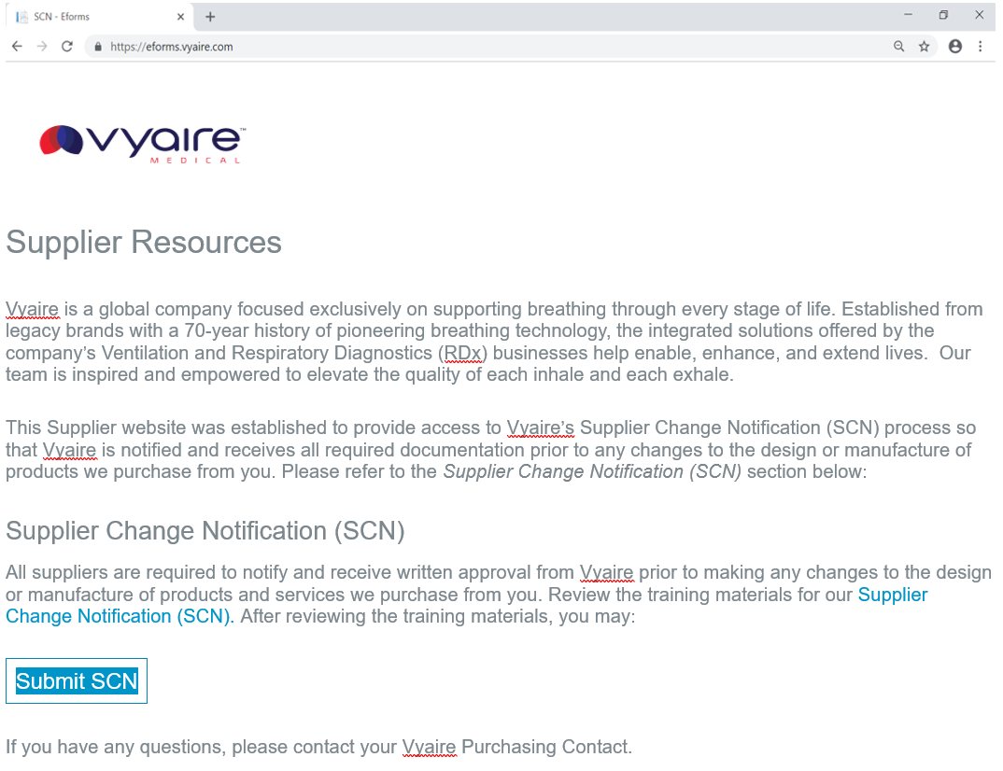
Vyaire.com Supplier Website
1. Visit https://eforms.vyaire.com
1
2
2. Click here to access SCN Web submission form

Slide 7
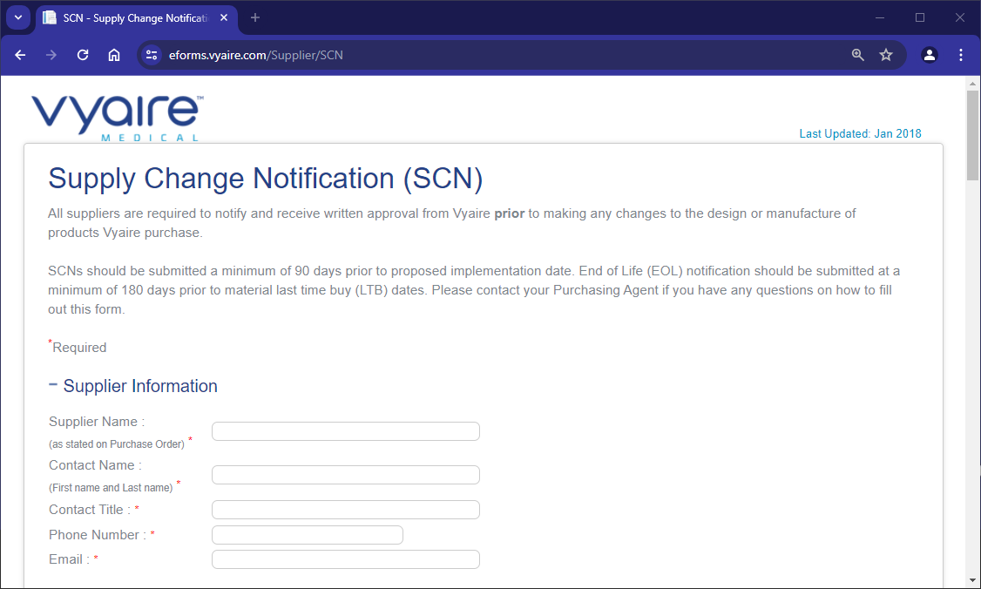
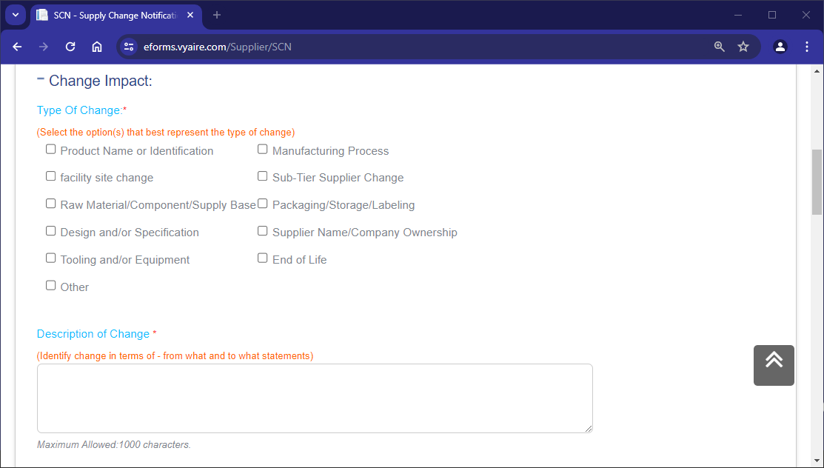
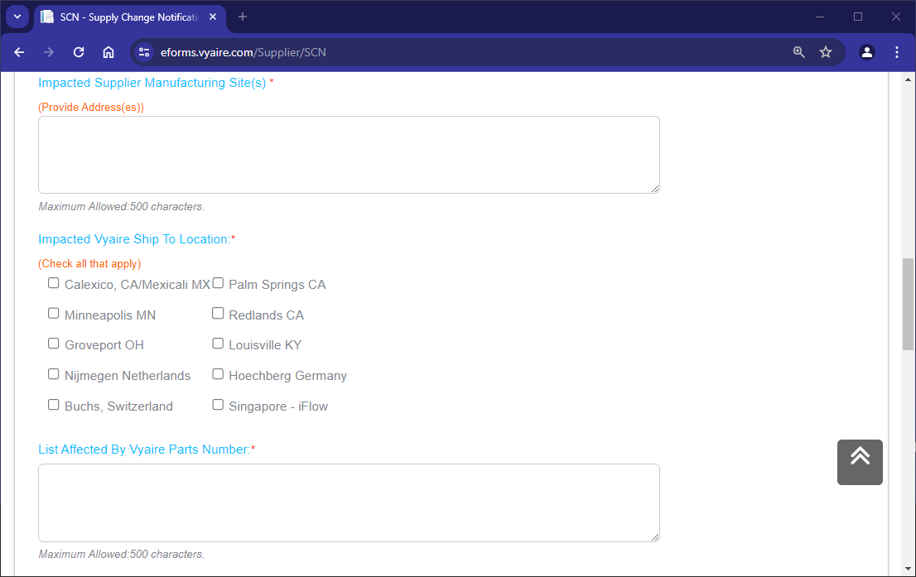
https://eforms.vyaire.com Supplier SCN form
3. Complete “Supplier Information” according to template
3
4. Supplier to select under Change Impact:
“Type of Change”
4
5
5. Please select ‘Impacted Vyaire site location”
6. List affected PN’s)
6

Slide 8
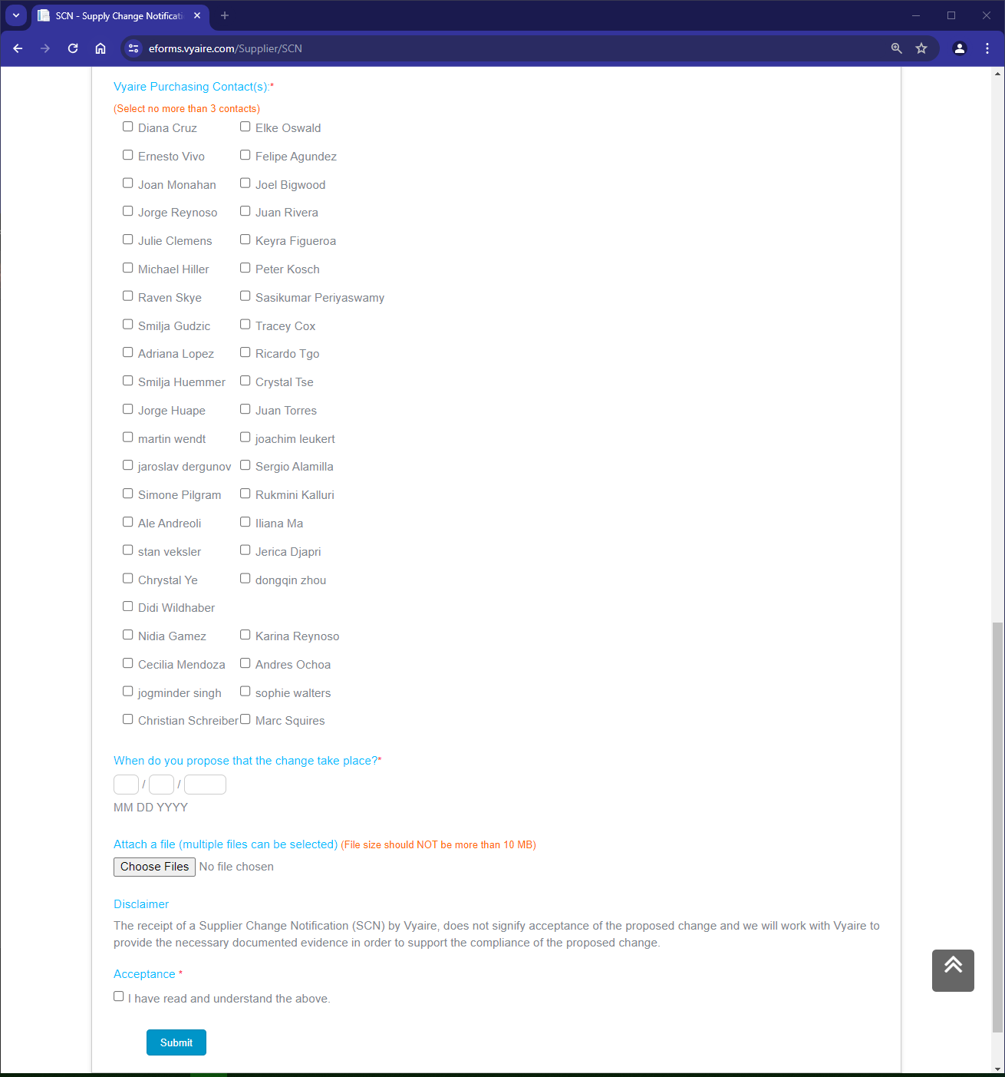
https://eforms.vyaire.com Supplier SCN form
7
7. Select Buyer contact
8. Tentative propose date
9. Attach supportive docs
10. Acceptance
8
9
10

Slide 9
Supplier(s) Responsibilities
1. Access Vyaire web site and complete training.
2. Submit SCN’s with a minimum of 90 days prior to proposed implementation.
3. SCNs for End of Life (EOL) notification shall be submitted at a minimum 180 days prior to material last time buy (LTB) dates.
4. Collaborate with Vyaire Team in SCN activities.
5. Support SCN completion and Closure.

Slide 10
SCN Status Definitions
Status | Definition
Approved to Proceed | Status in the SCN portal that will be selected when the change has been reviewed by Vyaire and action plan for the supplier or for Vyaire has been determined. Selecting this status means that both Vyaire and/or the supplier will start the implementation phase of the SCN. This change of status might work as a written approval for supplier to proceed with requested changes.
Review In-Process | Default status assigned by the SCN portal to new SCNs. Indicating need for review by SET and applicable SMEs. Upon review this status either go to Approved to Proceed or Rejected.
Rejected | This status can apply to an SCN when it has been decided to not to proceed with the change.
Supplier Retracted | This status will be selected by Vyaire when the supplier notifies Vyaire that the change is no longer required.

